Slide 1
RLTK

Slide 2
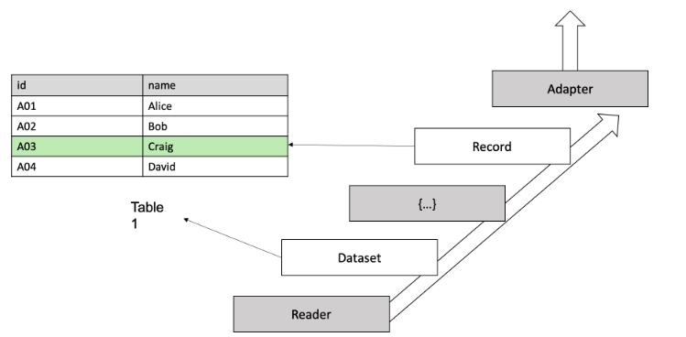
Basic Component and Data Flow on RLTK:

Slide 3
Components of Data Flow on RLTK:
Reader
Record
Dataset
Adapter
handles input data and return raw object that is dictionary object of each record.
represents rows of table. Allows to add our own feature based on the rows with two decorator i.e. property and cached_property.
collection of record. At the end data is required to be converted to rltk Dataset where each row must be record.
Store where all records get store may be memory or persistent. In case of large data, we store the generated records to persistent so that we can simply call it from there to save time of processing from next time.

Slide 4
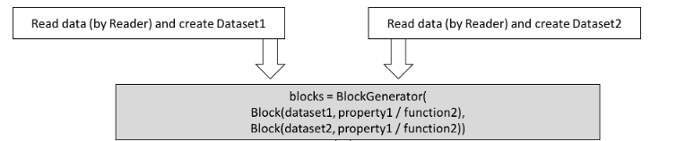
Blocking on RLTK:
Blocking is done by providing property_name/field_name or functions that specifies what to match between between two records. E.g. first_name, functions that return n-grams to be matched, etc.

Slide 5
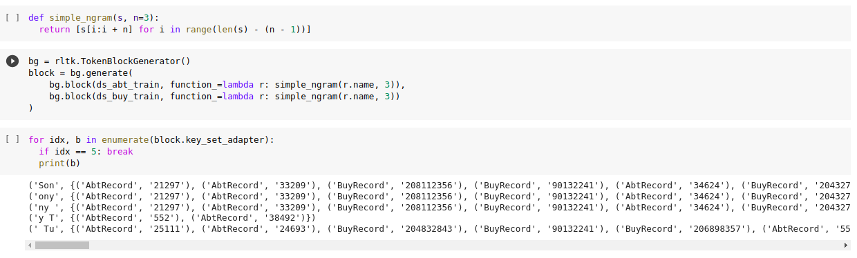
Example of blocking using function that generates 3-gram to be matched among the records.

Slide 6
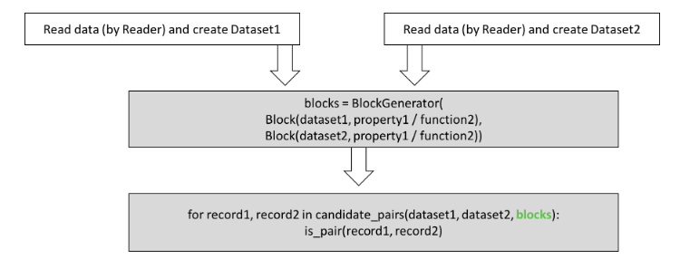
Getting results on RLTK:
The function is is_pair represent the method to classify where pairs within block is match or not. This function may be anything based on our use case i.e. some handcraft rule or some ML solutions.

Slide 7
Generating Feature Vectors for ML based approach on RLTK:
Feature vectors is generally generated by listing similarity scores among different field or property.
RLTK has some inbuilt similarity functions such as tf-idf scores, jaccard index similarity, etc. But we can introduce our own similarity functions as per use cases,

Slide 8
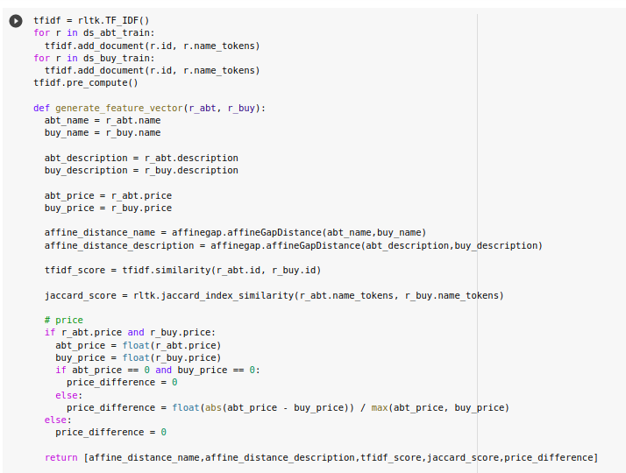
Simple example of generating feature vectors with different similarity scores

Slide 9
How RLTK handles different field names in different source
It is not necessary that fields-name must same as we simply specify which field from one data source is to be compared with another field from another data source during both feature generation and block generation part..
Data Source 1
Fullname
Similar Scores
Last Name
Data Source 2
Name
Field Name of Data Source 1
Field Name of Data Source 2
Feature Vector

Slide 10
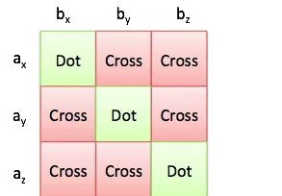
Labelled Data for classification on RLTK:
Doesn’t have inbuilt active learning or labelling pipeline.
Labelled Data is compulsory at least positive ones (i.e. matching records).
If we only have positive labelled data, it provides functionality to generate negative labels within the datasets such that we can train our classifier.
One example of generating negative labels is shown below.
Cross represents the generated negative labels by cross product of ids in the true matches
Dot represent the labelled match provided

Slide 11
Classification on RLTK:
Since we now will have positive and negative labelled data we can use any binary classifier of our choice that will fit well of our data.

Slide 12
DEDUPE

Slide 13
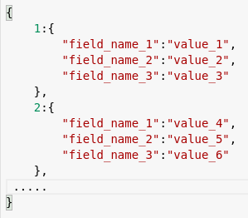
Data Format For Dedupe:
Dedupe expects data to be in nested key-value pair where outer key is unique id and value is again another key-value pair where key are the field names and values are the value for respective fields for each row.

Slide 14
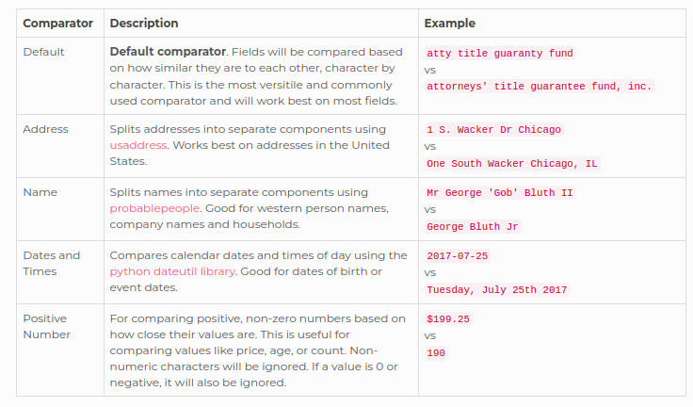
Field Comparators on Dedupe:
Dedupe has list of simple and advanced field comparators that we can use based on the data we have. Below is the list of simple field comparators available to use. We can also build our own comparators.
It is responsible for both blocking and feature generation so, we must be very careful while assign the field comparator to each fields.

Slide 15
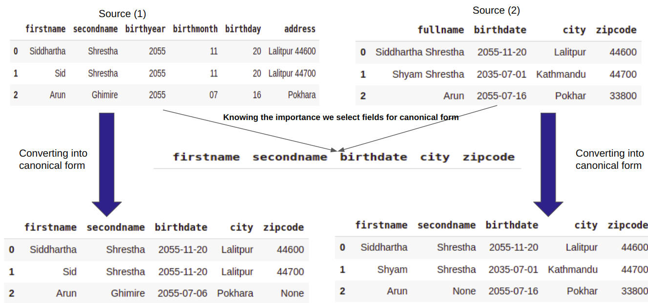
Dedupe handles different field names in different source by taking all data source to canonical or standard form

Slide 16
Blocking on Dedupe:
Based on the field comparators used, dedupe by default set multiple predicate rules and inverted indexes as a blocking schema.
And combining multiple schema will result in better blocking than just using single schema.
Data Source
If we apply one blocking schema i.e. matching birth year, we get following block.
0 | 1 | 2
Index of records in generated block i)
And if we combine two blocking schema i.e. say matching birth year and second name, we get following block
0 | 1
Index of records in generated block
We can clearly see that block ii) is more accurate block than i) as index 2 is included in block i) but not on block ii)

Slide 17
Blocking on Dedupe:
When these are combined dedupe can have hundreds of possible blocking rules to choose from.
Finally, while training dedupe also learns about blocking rules and it’s combination to get a small set of these rules that covers every labeled duplicated pair but minimizes the total number pairs using Chvatal’s Greedy Set Algorithm.

Slide 18
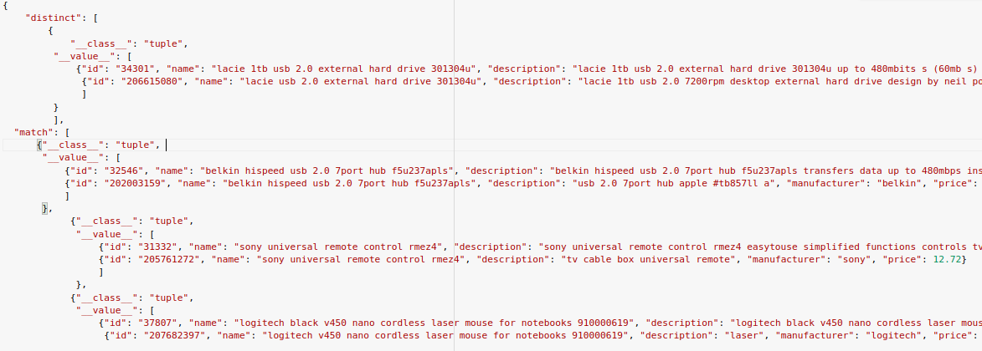
Labelled Data for classification on Dedupe:
Active Learning: Dedupe randomly sets pairs of record from the block which are a bit confusing and ask domain experts to label it match or distinct. And generate training data in key-value pair where keys are “match” or “distinct”.
Already Labelled Data: We can also load true data if we already have them. We just need to convert it to required key-value pairs. And important thing to remember is that data must be such that from which dedupe can learn blocking rules as well.

Slide 19
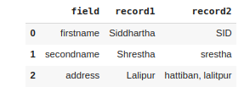
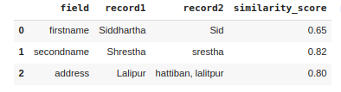
Generating Feature Vectors for Classification on Dedupe:
Feature are generated by concatenating similarity score based on used field comparator for respective field.
Similarity scores
Feature Vector
[0.65,0.82,0.80]

Slide 20
Classification on Dedupe:
Now, since we have feature vector and label for some feature vectors. We train Binary Classification models.
By default, Dedupe uses Regularized Logistic Regression.
But we can change it to our required binary classification model.

Slide 21
Clustering on Dedupe
Now, after classification we have match and distinct result for pair of records.
C
??
A
A
B
B
C
match
match
We would know A matches with B and B matches with C but still we won’t know that if A and C matches.
So, Dedupe uses Hierarchical Clustering with centroid linkage to group the same entity into one cluster.

Slide 22
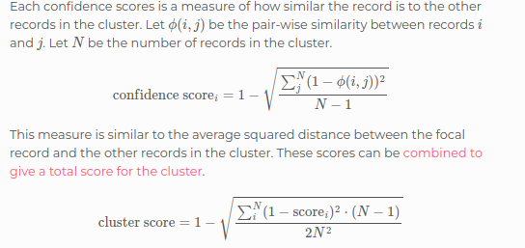
Mathematical Calculation on how Dedupe calculates cluster confidence score

